Slide 1


Конструкторы и деструкторы: Несколько вещей, которые вы, возможно, захотите узнать Constructors and destructors: A few things you might want to know
Pavel Novikov
@cpp_ape
R&D Align Technology

Slide 2
Let’s discuss
rule of zero, rule of three, rule of five, and when to break them
copying and moving, and equivalency
constructor overloading
explicit constructors
constexpr constructors and destructors
destructors are noexcept by default
destructors should be virtual for polymorphic types
C++20: constrained destructors

Slide 3




Pop quiz!
itempool.com/cpp-ape/live
For people watching a recording:
itempool.com/cpp-ape/c/N87Ez5EAp3f
Before you proceed you must answer our question

Slide 4

Rule of zero special functions
struct Widget {
std::string name;
int awesomeness;
};
Widget dummy;
auto widget = Widget{ "Cool widget😎", 9000 };
auto copy = widget;
auto moved = std::move(widget);
C++ Core Guidelines:
C.20: If you can avoid defining default operations, do

Slide 5
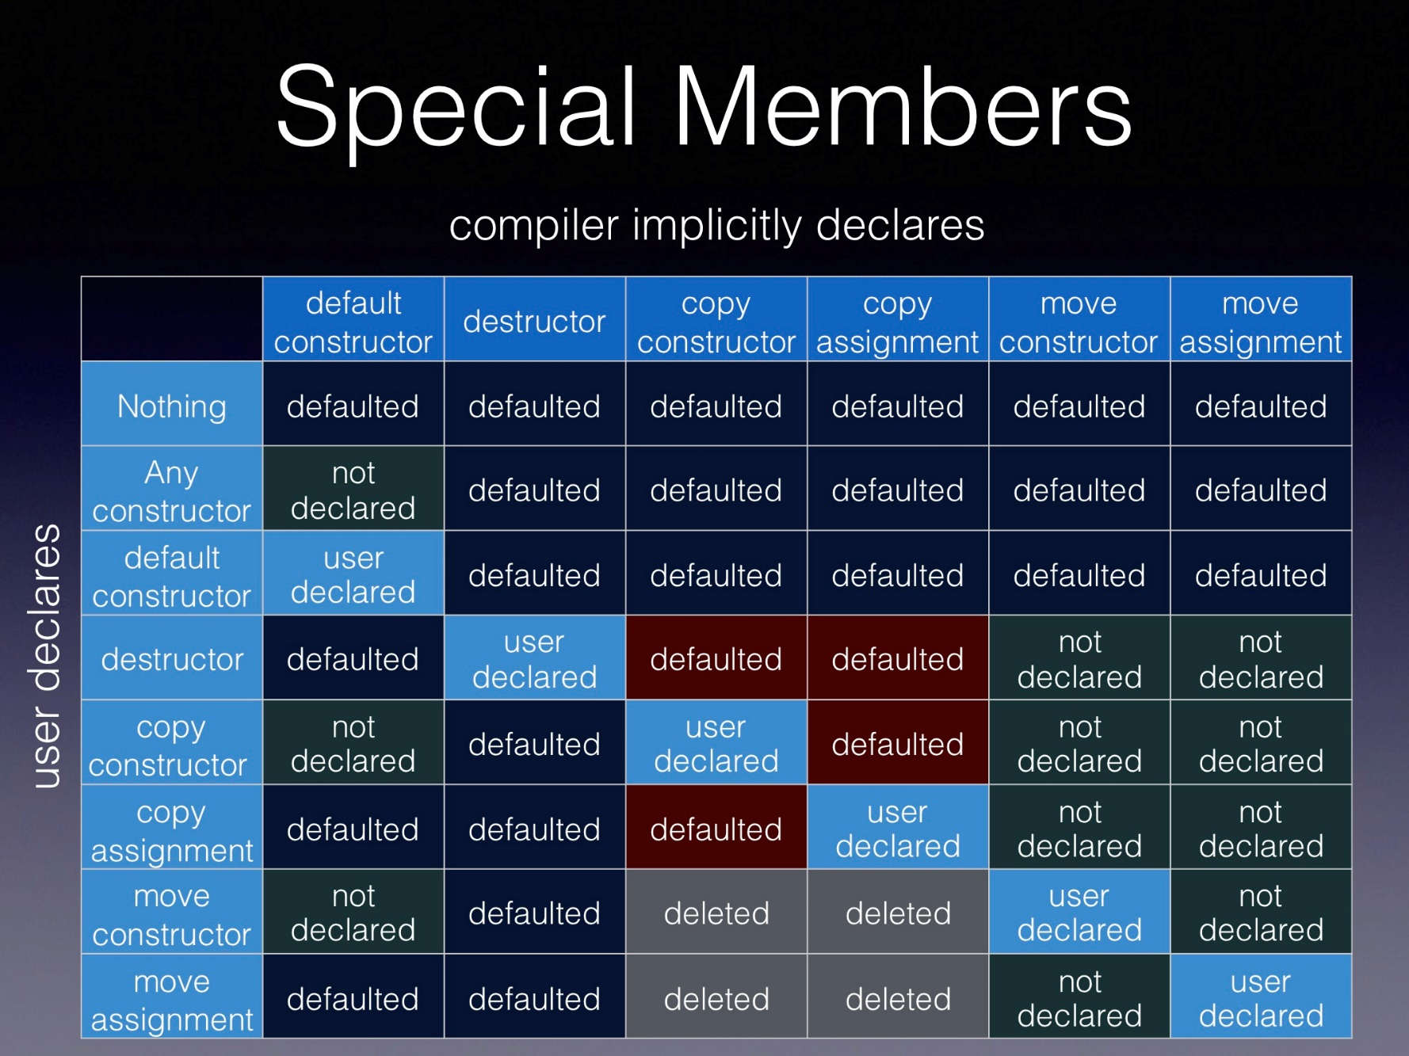


Rule of zero special functions
Howard Hinnant’s table
easy
hard!

Slide 6
Rule of zero special functions
struct Widget {
std::string name;
int awesomeness;
//inline Widget(const Widget&) noexcept(false) = default;
//inline Widget(Widget&&) noexcept = default;
//inline ~Widget() noexcept = default;
//inline Widget() noexcept = default;
};
Widget dummy;
auto widget = Widget{ "Cool widget ", 9000 };
auto copy = widget;
auto moved = std::move(widget);
generated by compiler

Slide 7
Rule of zero special functions
struct CopyableMovable {
void set(std::string_view q, int a) {
theQuestion = q;
theAnswer = a;
}
void print() {
std::cout << "Q: " << theQuestion << "\n"
"A: " << theAnswer << '\n';
}
private:
std::string theQuestion;
int theAnswer;
};

Slide 8
Rule of zero special functions
CopyableMovable a;
a.set("What's the answer to the ultimate question of the life?", 42);
auto b = a;
a.print();
auto c = std::move(a);
a.print(); // do not use moved from objects!
outputs:
Q: What's the answer to the ultimate question of the life?
A: 42
Q:
A: 42

Slide 9
Rule of three special functions
Howard Hinnant’s table

Slide 10
Rule of three special functions
struct Copyable {
Copyable() = default;
~Copyable() {
free(resource);
}
Copyable(const Copyable &other) :
resource{ clone(other.resource) } {
}
Copyable &operator=(const Copyable &other) {
auto oldResource = std::exchange(resource, clone(other.resource));
free(oldResource);
return *this;
}
private:
Resource resource = acquireResource();
};
default ctor for convenience
(and possibly other ctors)
the three special special functions

Slide 11
Rule of three special functions
default ctor
Copyable gadget, fidget;
auto copy = gadget;
auto copy2 = std::move(gadget);
copy = fidget;
copy2 = std::move(fidget);
copy ctor
copy assignment

Slide 12
Rule of five special functions
Howard Hinnant’s table

Slide 13
Rule of five special functions
C++ Core Guidelines:
C.21: If you define or =delete any copy, move, or destructor function, define or =delete them all
struct CopyableMovable {
CopyableMovable();
~CopyableMovable();
CopyableMovable(const CopyableMovable &other);
CopyableMovable &operator=(const CopyableMovable &other);
CopyableMovable(CopyableMovable &&other) noexcept;
CopyableMovable &operator=(CopyableMovable &&other) noexcept;
};
the five special special functions

Slide 14
Rule of five special functions
default ctor
CopyableMovable gadget, fidget;
auto copy = gadget;
auto moved = std::move(gadget);
copy = fidget;
moved = std::move(fidget);
copy ctor
move ctor
copy assignment
move assignment

Slide 15
Rules are there to break them
Rule of three
+
Rule of five (C++ Core Guidelines):
C.21: If you define or =delete any copy, move, or destructor function, define or =delete them all
Let’s break them!

Slide 16
Rules are there to break them
struct MovableNonCopyable {
MovableNonCopyable();
~MovableNonCopyable();
MovableNonCopyable(const MovableNonCopyable&) = delete;
MovableNonCopyable &operator=(const MovableNonCopyable&) = delete;
MovableNonCopyable(MovableNonCopyable&&) noexcept;
MovableNonCopyable &operator=(MovableNonCopyable&&) noexcept;
};
MovableNonCopyable gadget, fidget;
auto copy = gadget; // does not work
auto moved = std::move(gadget);
copy = fidget; // does not work
moved = std::move(fidget);

Slide 17
Rules are there to break them
itempool.com/cpp-ape/live
std::vector<MovableNonCopyable> items;
MovableNonCopyable item;
items.push_back(item);
items.push_back(std::move(item));
items.push_back(MovableNonCopyable{});
Item 1

Slide 18
Rules are there to break them
struct MovableNonCopyable {
MovableNonCopyable();
~MovableNonCopyable();
MovableNonCopyable(const MovableNonCopyable&) = delete;
MovableNonCopyable &operator=(const MovableNonCopyable&) = delete;
MovableNonCopyable(MovableNonCopyable&&) noexcept;
MovableNonCopyable &operator=(MovableNonCopyable&&) noexcept;
};
rule of three?

Slide 19
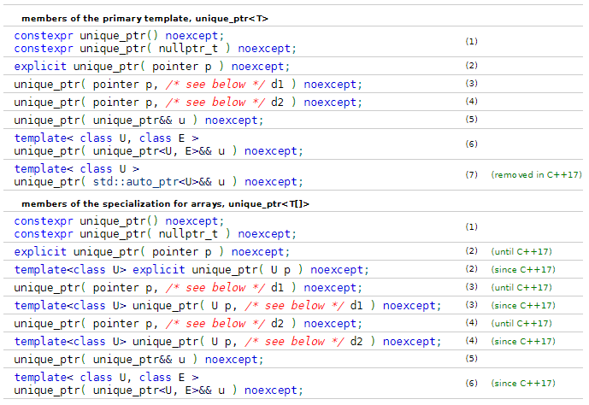
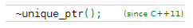
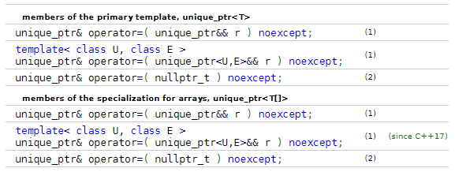
unique_ptr( unique_ptr&& u ) noexcept;
~unique_ptr();
unique_ptr& operator=( unique_ptr&& r ) noexcept;
rule of three?

Slide 20
Rules are there to break them
struct CopyableNonMovable {
CopyableNonMovable();
~CopyableNonMovable();
CopyableNonMovable(const CopyableNonMovable&);
CopyableNonMovable &operator=(const CopyableNonMovable&);
CopyableNonMovable(CopyableNonMovable&&) = delete;
CopyableNonMovable &operator=(CopyableNonMovable&&) = delete;
};
CopyableNonMovable gadget, fidget;
auto copy = gadget;
auto moved = std::move(gadget); // does not work
copy = fidget;
moved = std::move(fidget); // does not work

Slide 21
Rules are there to break them
itempool.com/cpp-ape/live
std::vector<CopyableNonMovable> items;
CopyableNonMovable item;
items.push_back(item); // ❌MSVC std lib ✔stdlibc++ ❌libc++
items.push_back(std::move(item)); // ❌ all standard libs
items.push_back(CopyableNonMovable{}); // ❌ all standard libs
Item 2

Slide 22
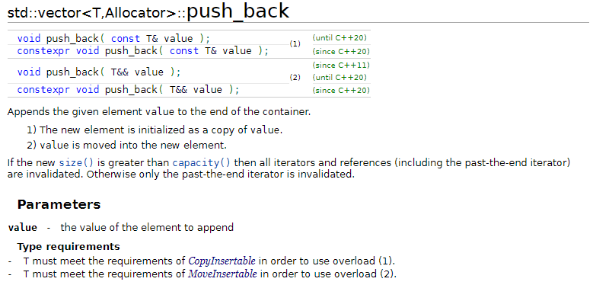
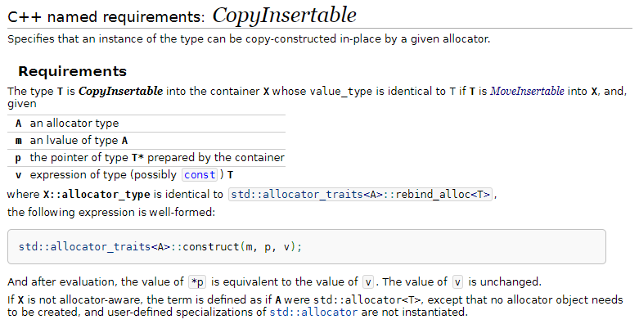
Type requirements
T must meet the requirements of CopyInsertable in order to use overload (1).
T must meet the requirements of MoveInsertable in order to use overload (2).
Requirements
The type T is CopyInsertable into the container X whose value_type is identical to T if T is MoveInsertable into X…

Slide 23
Copying and moving, and equivalency
struct Gadget {
Gadget() { std::cout << "Ctor;"; }
~Gadget() { std::cout << "Dtor;"; }
Gadget(const Gadget &other) { std::cout << "Copy;"; }
//...
};

Slide 24
Copying and moving, and equivalency
itempool.com/cpp-ape/live
struct Gadget {
Gadget() { std::cout << "Ctor;"; }
~Gadget() { std::cout << "Dtor;"; }
Gadget(const Gadget &other) { std::cout << "Copy;"; }
//...
};
Item 3
Gadget getGadget() {
return {};
}
int main() {
auto g1 = getGadget();
}
Gadget getGadgetCopy() {
Gadget gadget;
return gadget;
}
int main() {
auto g2 = getGadgetCopy();
}

Slide 25
Copying and moving, and equivalency
11 Classes [class]
11.10 Initialization [class.init]
11.10.6 Copy/move elision [class.copy.elision]
1 When certain criteria are met, an implementation is allowed to omit the copy/move construction of a class object, even if the constructor selected for the copy/move operation and/or the destructor for the object have side effects.
In such cases, the implementation treats the source and target of the omitted copy/move operation as simply two different ways of referring to the same object.
If the first parameter of the selected constructor is an rvalue reference to the object's type, the destruction of that object occurs when the target would have been destroyed; otherwise, the destruction occurs at the later of the times when the two objects would have been destroyed without the optimization.

Slide 26
Copying and moving, and equivalency
11 Classes [class]
11.10 Initialization [class.init]
11.10.6 Copy/move elision [class.copy.elision]
1 When certain criteria are met, an implementation is allowed to omit the copy/move construction of a class object, even if the constructor selected for the copy/move operation and/or the destructor for the object have side effects.
In such cases, the implementation treats the source and target of the omitted copy/move operation as simply two different ways of referring to the same object.
If the first parameter of the selected constructor is an rvalue reference to the object's type, the destruction of that object occurs when the target would have been destroyed; otherwise, the destruction occurs at the later of the times when the two objects would have been destroyed without the optimization.

Slide 27
Constructor overloading
struct Fidget {
Fidget() = default;
//...
private:
Fidget(const Fidget&);
};
struct Fidget {
Fidget() = default;
Fidget(const Fidget&) = delete;
//...
};
Fidget f;
auto g = f;
MSVC
Clang
'Fidget::Fidget': cannot access private member declared in class 'Fidget'
calling a private constructor of class 'Fidget'
'Fidget::Fidget(const Fidget &)': attempting to reference a deleted function
call to deleted constructor of 'Fidget'

Slide 28
Constructor overloading
overload set:
Fidget
struct Fidget {
Fidget() = default;
//...
private:
Fidget(const Fidget&);
};
struct Fidget {
Fidget() = default;
Fidget(const Fidget&) = delete;
//...
};
overload set:
Fidget
Fidget f;
auto g = f;
overload resolution

Slide 29
Constructor overloading
struct Fidget {
Fidget() { init(); }
Fidget(std::string_view featureList) :
coolness{ getCoolnessFromFeatures(featureList) } {
init();
}
Fidget(double speed) : coolness{ getCoolnessFromSpeed(speed) } {
init();
}
private:
void init();
int coolness = 0;
//...
};
Fidget f{ 9000 };

Slide 30
Constructor overloading
itempool.com/cpp-ape/live
struct Fidget {
Fidget() : Fidget{ 0 } {}
Fidget(std::string_view featureList) :
Fidget{ getCoolnessFromFeatures(featureList) } {}
Fidget(double speed) : Fidget{ getCoolnessFromSpeed(speed) } {}
private:
Fidget(int coolness) : coolness{ coolness } {
// init
}
int coolness;
//...
};
Item 4
delegating constructors
Fidget f{ 9000 };

Slide 31
Constructor overloading
struct Fidget {
Fidget();
Fidget(std::string_view featureList);
Fidget(double speed);
private:
Fidget(int coolness);
//...
};
Fidget f{ 9000 }; // old code is broken
Fidget f{ 9000.0 };

Slide 32


Slide 33
Constructor overloading
struct Fidget {
Fidget();
Fidget(std::string_view);
private:
Fidget(int);
};
struct Gizmo : Fidget {
using Fidget::Fidget;
Gizmo(double);
};
Fidget f{ 42 };
Gizmo g{ 42 };
inherited constructors
cannot access private constructor

Slide 34
Constructor overloading
struct Fidget {
Fidget() : Fidget{ Coolness{ 0 } } {}
Fidget(std::string_view featureList) :
Fidget{ Coolness{ getCoolnessFromFeatures(featureList) } } {}
Fidget(double speed) :
Fidget{ Coolness{ getCoolnessFromSpeed(speed) } } {}
private:
struct Coolness { int value; };
Fidget(Coolness coolness) : coolness{ coolness.value } {
// init
}
int coolness;
//...
};
struct Gizmo : Fidget {
using Fidget::Fidget;
Gizmo(double);
};
Fidget f{ 42 }; // ✔
Gizmo g{ 42 }; // ✔

Slide 35
=delete unwanted functions/oveloads
when overloading, make behavior consistent (the principle of least surprise)
remember that private member functions participate in overload resolution
avoid using std::initializer_list in your interfaces or use with extreme caution!
struct Noncopyable {
Noncopyable() {}
Noncopyable(const Noncopyable &) = delete;
Noncopyable &operator=(const Noncopyable &) = delete;
};
struct Fidget {
Fidget(double speed);
private:
Fidget(int coolness);
};
Fidget f{ 9000 }; // broken!
std::vector<int> v1(42); // 42 '0' elements
std::vector<int> v2{ 42 }; // one '42' element

Slide 36
Make constructors explicit by default
struct Fidget {
Fidget();
explicit Fidget(std::string_view featureList);
explicit Fidget(double speed);
//...
};
void fiddleWith(const Fidget &f);
fiddleWith(42); // can't convert from number to Fidget
fiddleWith(Fidget{ 42 }); // ✔

Slide 37
Make constructors explicit by default
struct Foo {
//...
explicit Foo(double, double);
};

Slide 38

Let’s refactor some more!
https://prettybigpickles.com/
void setupOrder(
std::string_view name,
uint64_t priceToBuyInDollars, // buy if cheaper than priceToBuyInDollars
uint64_t sumToSpendInDollars, // amount of money to spend buying stocks
uint64_t priceToSellInDollars, // sell if more expensive than priceToSellInDollars
uint32_t stocksToSell // number of stocks to sell
);
void setupOrder(std::string_view, uint64_t, uint64_t, uint64_t, uint32_t);
? ? ? ?
setupOrder("SNDP", 10, 1000000, 20, 1000);

Slide 39
Let’s refactor some more!
struct Buy {
uint64_t priceToBuyInDollars;
uint64_t sumToSpendInDollars;
};
struct Sell {
uint64_t priceToSellInDollars;
uint32_t stocksToSell;
};
void setupOrder(std::string_view name,
const Sell&,
const Buy&);

Slide 40
Let’s refactor some more!
setupOrder("SNDP", { 10, 1000000 }, { 20, 1000 });

Slide 41
Let’s refactor some more!
itempool.com/cpp-ape/live
setupOrder("SNDP", { 10, 1000000 }, { 20, 1000 });
Item 5

Slide 42
Let’s refactor some more!
// buy $, $ to spend, sell $, N stocks
setupOrder("SNDP", 10, 1000000, 20, 1000 );
void setupOrder(std::string_view, const Sell&, const Buy& );
setupOrder("SNDP", { 10, 1000000 }, { 20, 1000 });

Slide 43
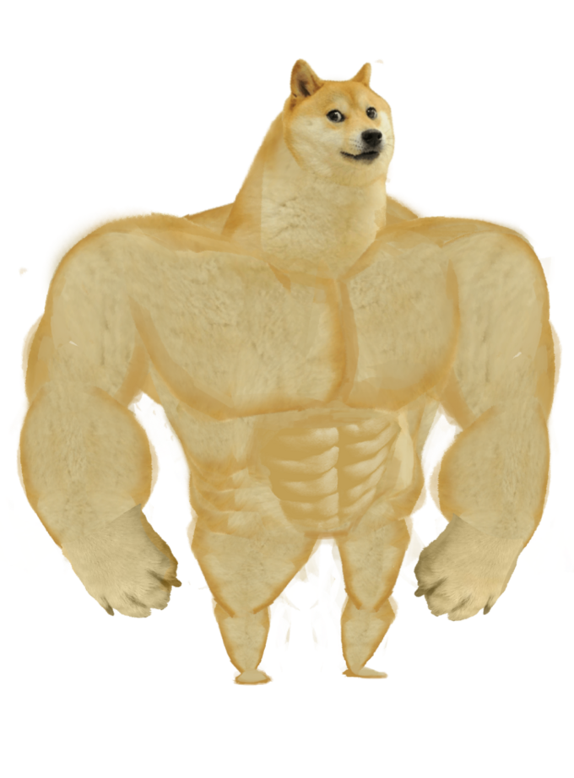
Strong types

Slide 44
Strong types
struct Buy {
explicit Buy(uint64_t priceToBuyInDollars, uint64_t sumToSpendInDollars) :
priceToBuyInDollars(priceToBuyInDollars),
sumToSpendInDollars(sumToSpendInDollars)
{}
uint64_t priceToBuyInDollars;
uint64_t sumToSpendInDollars;
};

Slide 45
Strong types
struct Sell {
explicit Sell(uint64_t priceToSellInDollars, uint32_t stocksToSell) :
priceToSellInDollars(priceToSellInDollars),
stocksToSell(stocksToSell)
{}
uint64_t priceToSellInDollars;
uint32_t stocksToSell;
};

Slide 46
Strong types
void setupOrder(std::string_view name, const Sell&, const Buy&);
setupOrder("SNDP", { 10, 1000000 }, { 20, 1000 }); // doesn’t work
setupOrder("SNDP", Buy{ 10, 1000000 }, Sell{ 20, 1000 }); // nope
setupOrder("SNDP", Sell{ 20, 1000 }, Buy{ 10, 1000000 }); // ✔

Slide 47
Strong types
setupOrder("SNDP", Sell{ 20, 1000 }, Buy{ 10, 1000000 });
setupOrder("SNDP", Sell{ 20_$, 1000 }, Buy{ 10_$, 1000000_$ });

Slide 48
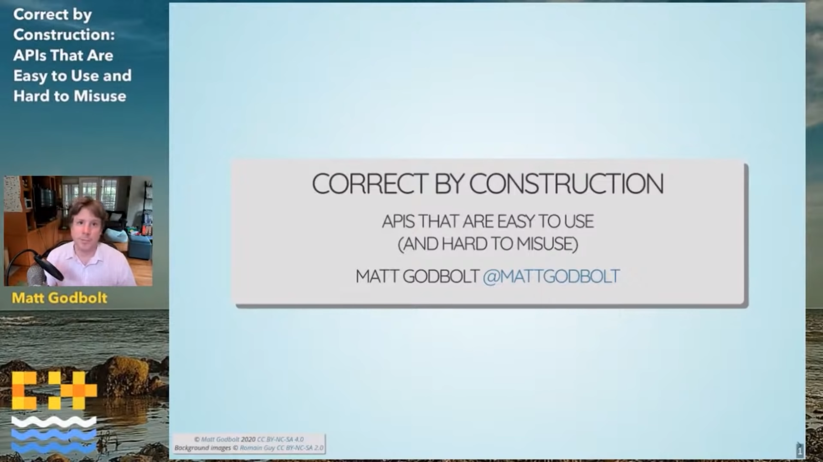
Correct by construction: APIs That Are Easy to Use and Hard to Misuse
by Matt Godbolt
https://youtu.be/nLSm3Haxz0I

Slide 49
Consider making ctors and dtors constexpr
struct Foo {
int bar;
double baz;
};
constexpr auto foo = Foo{ 42, 1.618033988749895 };
constexpr Foo getFoo();
constexpr auto foo = getFoo();
constinit auto foo = getFoo(); // C++20
literal types

Slide 50
Consider making ctors and dtors constexpr
literal type
struct Fidget {
constexpr Fidget();
explicit constexpr Fidget(std::string_view featureList);
explicit constexpr Fidget(double speed);
private:
int coolness = 0;
//...
};
constexpr auto f1 = Fidget{};
constexpr auto f2 = Fidget{ "shiny" };
constexpr auto f3 = Fidget{ 9000 };
trivial destructor

Slide 51
Consider making ctors and dtors constexpr
literal type in C++20
struct Fidget {
constexpr Fidget();
constexpr ~Fidget();
explicit constexpr Fidget(std::string_view featureList);
explicit constexpr Fidget(double speed);
private:
int coolness = 0;
//...
};
constexpr auto f1 = Fidget{};
constexpr auto f2 = Fidget{ "shiny" };
constexpr auto f3 = Fidget{ 9000 };

Slide 52
Test yourself!
itempool.com/cpp-ape/live
struct Fidget {
//...
explicit constexpr Fidget(double speed) {
if (speed < 0.)
throw Error{ "speed must be non-negative" };
//...
}
//...
};
int main() {
constexpr auto fidget = Fidget{ -1. };
std::cout << "created a fidget\n";
}
Item 6

Slide 53
Consider making ctors and dtors constexpr
struct String {
constexpr String() = default;
constexpr ~String() {
delete[] storage;
}
constexpr String(const char *s) {
size = std::char_traits<char>::length(s);
storage = new char[size];
std::copy(s, s + size, storage);
}
private:
char *storage = nullptr;
size_t size = 0;
};

Slide 54
Consider making ctors and dtors constexpr
constexpr int process(const char *s) {
String string{ s };
//...
return result;
}
constexpr int processingResult = process("text to process!");
memory allocation
matched memory deallocation
string.~String()

Slide 55
Consider making ctors and dtors constexpr
These containers are literal types:
basic_string // C++20
vector // C++20
array
These views are literal types:
basic_string_view
span // C++20
Non-literal types
containers: deque, list, forward_list, sets & maps, unordered sets & maps
adaptors: queue, priority_queue, stack

Slide 56


Consider making ctors and dtors constexpr
void foo() { // not constexpr
//...
constexpr auto string = std::string{ " " }; // does not work
//...
}
constexpr auto string = std::string{ " " }; // does not work

Slide 57
Destructors are noexcept by default
struct Bar {
Bar();
~Bar();
};
void foo() {
Bar b;
throw "oops!";
}
noexcept
stack unwinding
b.~Bar()

Slide 58
Destructors are noexcept by default
struct Bar {
Bar();
~Bar();
};
struct Foo : Bar {
~Foo();
};
struct Baz {
~Baz();
Bar b;
};
C++ Core Guidelines:
C.37: Make destructors noexcept
noexcept
noexcept(false)
noexcept
noexcept(false)
noexcept(false)
noexcept

Slide 59
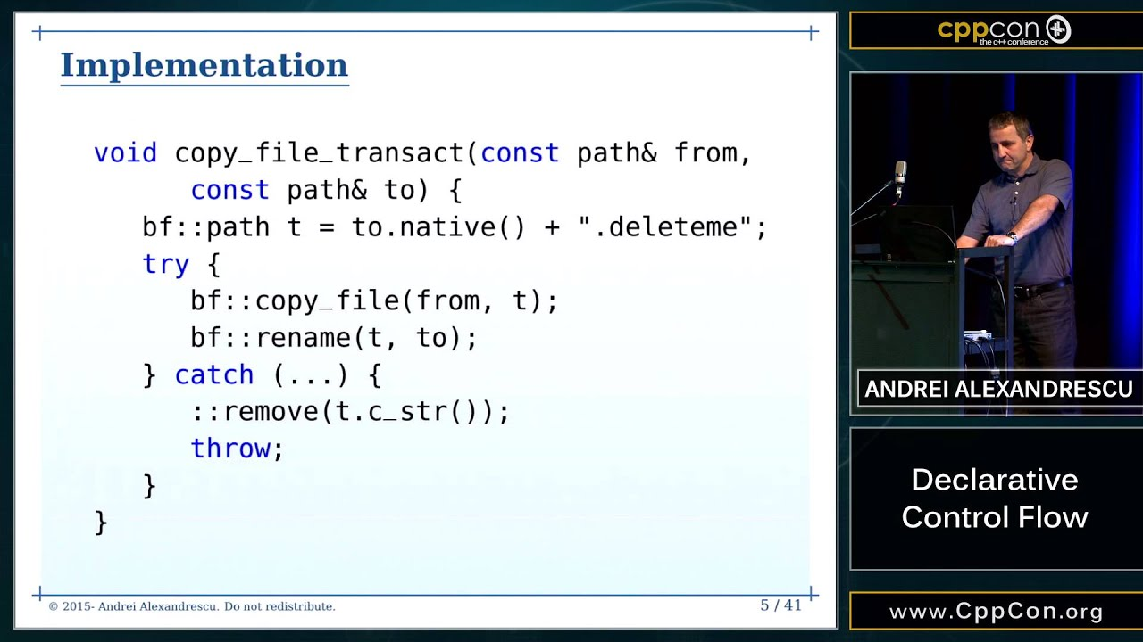
Destructors are noexcept by default
Andrei Alexandrescu "Declarative Control Flow"
https://youtu.be/WjTrfoiB0MQ

Slide 60
Destructors should be virtual for polymorphic types
struct ConnectionBase {
ConnectionBase();
virtual ~ConnectionBase();
void setEnabled(bool);
bool isEnabled() const;
private:
//...
};

Slide 61
Destructors should be virtual for polymorphic types
struct Connection : ConnectionBase { /*...*/ };
struct Connection1Arg : ConnectionBase { /*...*/ };
struct Subscription {
template<typename F>
std::shared_ptr<ConnectionBase> subscribe(F &&f) {
auto connection = std::make_shared<Connection>(/*...*/);
//...
return connection;
}
void notify();
private:
//...
};
Subscription subscription;
auto connection = subscription.subscribe([] { std::cout << "got event\n"; });
subscription.notify();
connection->setEnabled(false);

Slide 62
Destructors should be virtual for polymorphic types
itempool.com/cpp-ape/live
struct ConnectionBase {
//...
virtual ~ConnectionBase();
//...
};
struct Connection : ConnectionBase { /*...*/ };
struct Subscription {
template<typename F>
std::shared_ptr<ConnectionBase> subscribe(F &&f) {
auto connection = std::make_shared<Connection>(/*...*/);
//...
return connection;
}
//...
};
Item 7

Slide 63
Destructors should be virtual for polymorphic types
struct ConnectionBase {
ConnectionBase();
virtual ~ConnectionBase();
void setEnabled(bool);
bool isEnabled() const;
private:
//...
};
auto connection = subscription.subscribe(/*...*/);
connection->setEnabled(false);
not virtual, can not override in derived types

Slide 64
Destructors should be virtual for polymorphic types
Very simple rule:
polymorphic types (i.e. types with virtual functions) should have virtual destructor
struct Interface {
virtual ~Interface() = default;
virtual void abstractMethod() = 0;
virtual void methodWithBaseImplementation() {}
};
struct Instance : Interface {
void abstractMethod() override {}
};
if the type is not polymorphic, destructor should be non-virtual

Slide 65
C++20: constrained destructors
template<typename T> struct Optional {
Optional() = default;
Optional(T value) : value{ value }, hasValue{ true } {}
~Optional() {
if (hasValue)
value.~T();
}
private:
union {
int empty;
T value;
};
bool hasValue = false;
};

Slide 66
C++20: constrained destructors
template<typename T> struct Optional {
Optional() = default;
Optional(T value) : value{ value }, hasValue{ true } {}
~Optional() requires(!std::is_trivially_destructible_v<T>) {
if (hasValue)
value.~T();
}
~Optional() = default; // trivial dtor
private:
union {
int empty;
T value;
};
bool hasValue = false;
};
two prospective destructors

Slide 67

Thanks for watching!
itempool.com/cpp-ape/live
many interesting
much thanks
wow
very audience
so knowledge

Slide 68
Constructors and destructors: A few things you might want to know
Pavel Novikov
@cpp_ape
R&D Align Technology
Thanks to Howard Hinnant, Stephan T. Lavavej and Jennifer Yao for feedback and for answering my questions!
Slides: https://git.io/JkUJy

Slide 69
References
C++ Core Guidelines https://isocpp.github.io/CppCoreGuidelines/CppCoreGuidelines
Howard E. Hinnant. How I Declare My class And Why https://howardhinnant.github.io/classdecl.html
Working Draft, Standard for Programming Language C++ https://eel.is/c++draft/class.copy.elision
Matt Godbolt. Correct by construction: APIs That Are Easy to Use and Hard to Misuse https://youtu.be/nLSm3Haxz0I
Andrei Alexandrescu. Declarative Control Flow https://youtu.be/WjTrfoiB0MQ
C++ Extensions for Library Fundamentals, Version 3 https://en.cppreference.com/w/cpp/experimental/lib_extensions_3

Slide 70
Bonus slides

Slide 71
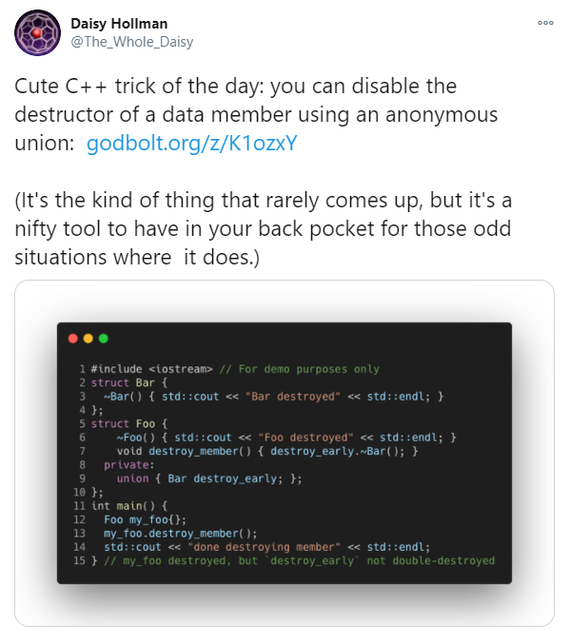
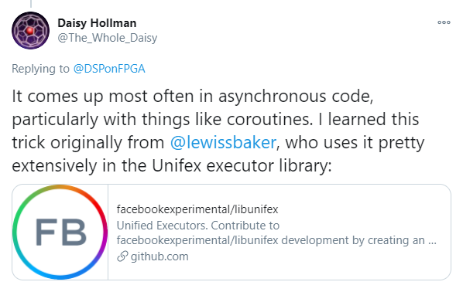
Don’t try this at home!
struct Foo {
Foo();
~Foo();
};
struct Bar {
~Bar() {}
void releaseResources() {
lifetimeManagedManually.~Foo();
}
private:
union {
Foo lifetimeManagedManually{};
};
};
Bar bar;
bar.releaseResources();

Slide 72
Exception guarantees
std::vector<T> items;
T item;
items.push_back(item);
If during move an exception is thrown, the state becomes inconsistent (“unspecified”), hence weaker exception guarantee.
If move is noexcept, the operation has strong exception guarantee, i.e. in case of an exception (e.g. bad_alloc) the state is not changed.
moved
exception

Slide 73
Strong types
struct Dollars {
explicit Dollars(uint64_t amount) : amount{ amount } {}
uint64_t amount;
};
auto operator""_$(uint64_t amount) {
return Dollars{ amount };
}

Slide 74
Strong types
struct Buy {
explicit Buy(Dollars priceToBuy, Dollars sumToSpend) :
priceToBuy(priceToBuy),
sumToSpend(sumToSpend)
{}
Dollars priceToBuy;
Dollars sumToSpend;
};
struct Sell {
explicit Sell(Dollars priceToSell, uint32_t stocksToSell) :
priceToSell(priceToSell),
stocksToSell(stocksToSell)
{}
Dollars priceToSell;
uint32_t stocksToSell;
};

Slide 75
Strong types
void setupOrder(std::string_view name, const Sell&, const Buy&);
setupOrder("SNDP", Sell{ 20_$, 1000 }, Buy{ 10_$, 1000000_$ });

Slide 76
Types of polymorphism
Set of operations | Set of types
 | known | unknown
known |  | virtual
unknown
struct Interface {
virtual ~Interface() = default;
virtual void abstractMethod() = 0;
virtual void methodWithBaseImplementation();
};
struct Instance : Interface {
void abstractMethod() override;
};
std::unique_ptr<Interface> instance = std::make_unique<Instance>();

Slide 77
Types of polymorphism
Set of operations | Set of types
 | known | unknown
known |  | virtual
unknown | variant
struct Ellipse {/*...*/};
struct Polygon {/*...*/};
std::variant<Ellipse, Polygon> shape{ Ellipse{} };
auto visitor = [](const auto &s) {
using T = std::remove_reference_t<decltype(s)>;
if constexpr (std::is_same_v<T, Ellipse>) {
// do ellipse stuff
}
else {
// do polygon stuff
}
};
std::visit(visitor, shape);

Slide 78
Types of polymorphism
Set of operations | Set of types
 | known | unknown
known | no polymorphism | virtual
unknown | variant

Slide 79
Types of polymorphism
Set of operations | Set of types
 | known | unknown
known | no polymorphism | virtual
unknown | variant | dynamic typing

Slide 80
Observing exceptions in constructors
struct Base {
Base(int);
};
struct Foo : Base {
Foo(std::string_view s) try : Base(42), member{ s } {
// rest of init
}
catch (...) {
// handle error
}//implicit 'throw;' here
private:
std::string member;
};

Slide 81
Constructing virtual base type in a hierarchy with multiple virtual inheritance
intentionally left blank

